Slide 1

Dayanada Sagar College of Engineering
MASTER OF COMPUTER APPLICATION
Relational Database Design Using ER to Relational Mapping
Submitted To
—prof.Mahendra kumar Sing
Presented by
—Priyanka chavan

Slide 2
Chapter Outline
◼Step 1: ER-to-Relational Mapping Algorithm
Step 1: Mapping of Regular Entity Types.
Step 2: Mapping of Weak Entity Types.
Step 3: Mapping of Binary 1:1 Relation Types.
Step 4: Mapping of Binary 1:N Relationship Types.
Step 5: Mapping of Binary M:N Relationship Types.
Step 6: Mapping of Multivalued attributes.

Slide 3
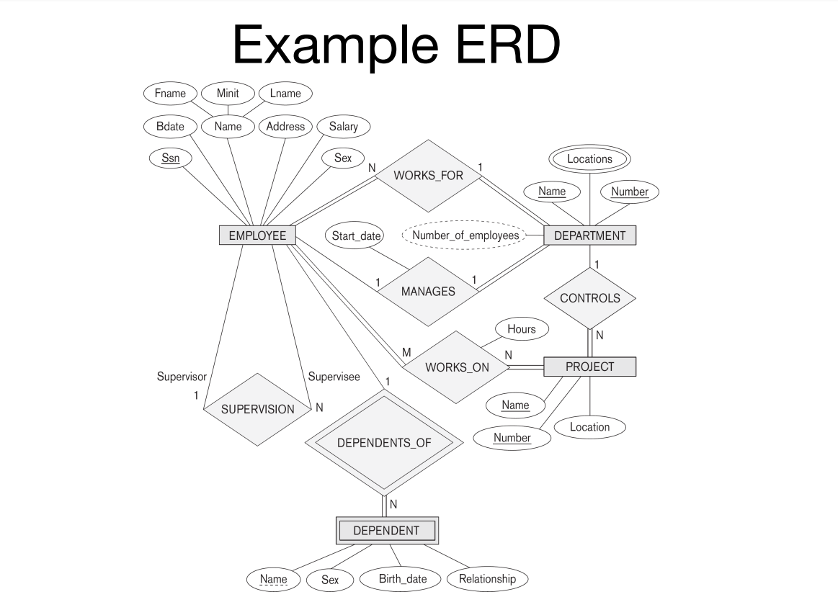
The ER conceptual schema diagram for the COMPANY database.

Slide 4
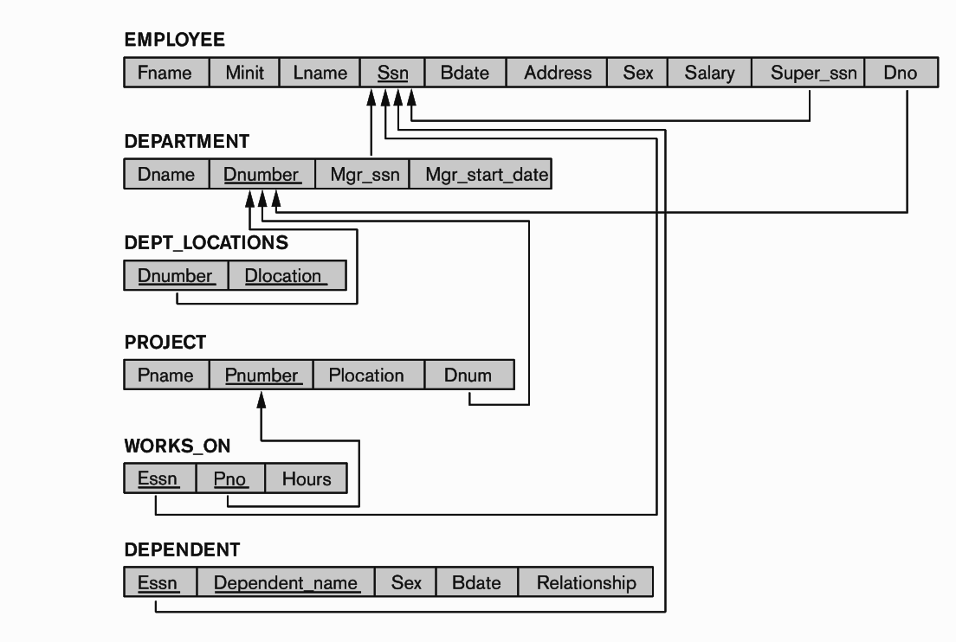
Result of Mapping the COMPANY ER Schema into a Relational Schema

Slide 5
◼ Step 1: ER-to-Relational Mapping Algorithm
For each regular/strong entity type, create a
corresponding relation that includes all the
simple attributes (includes simple attributes
of composite relations)
Choose one of the key attributes as primary key
If composite, the simple attributes together form
the primary key
Any remaining key attributes are kept as
secondary unique keys (these will be useful
for physical tuning w.r.t. indexing analysis)

Slide 6
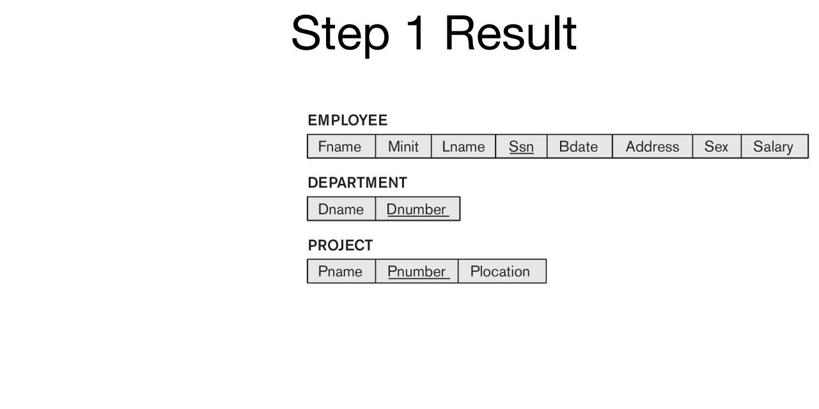

Slide 7
Step 2: Mapping of Weak Entity Types
For each weak entity type, create a corresponding relation that includes all the simple attributes
Add as a foreign key all of the primary key attribute(s) in the entity corresponding to the owner entity type
The primary key is the combination of all the primary key attributes from the owner and the partial key of the weak entity,

Slide 8
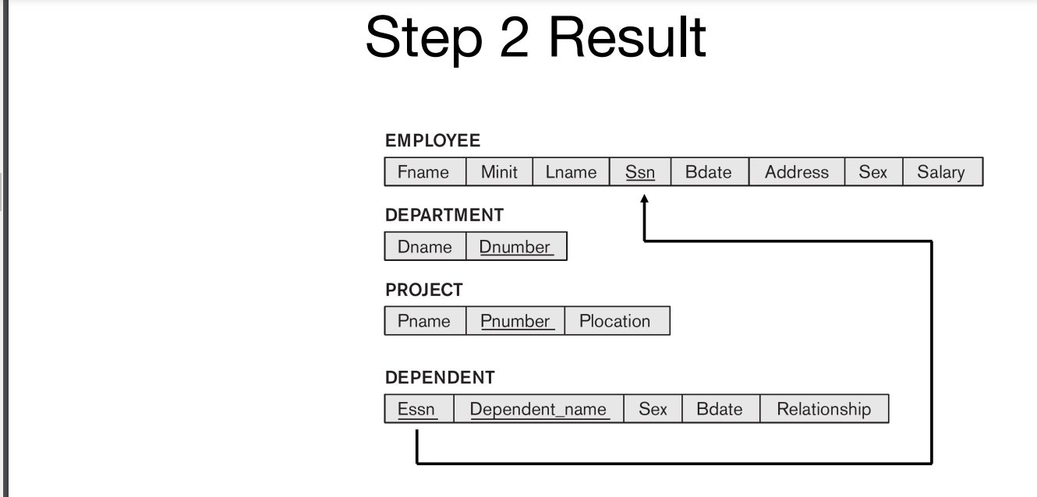

Slide 9
Step 3: Mapping Binary 1-to-1
Three approaches
– Foreign Key
Usually appropriate
– Merged Relation
Possible when both participations are total
– Relationship Relation

Slide 10
Continued….step 3
Foreign Key
i. Choose one relation as S, the other T § Better if S has total participation (reduces number of NULL values)
ii. Add to S all the simple attributes of the relationship
iii. Add as a foreign key in S the primary key attributes of T.

Slide 11
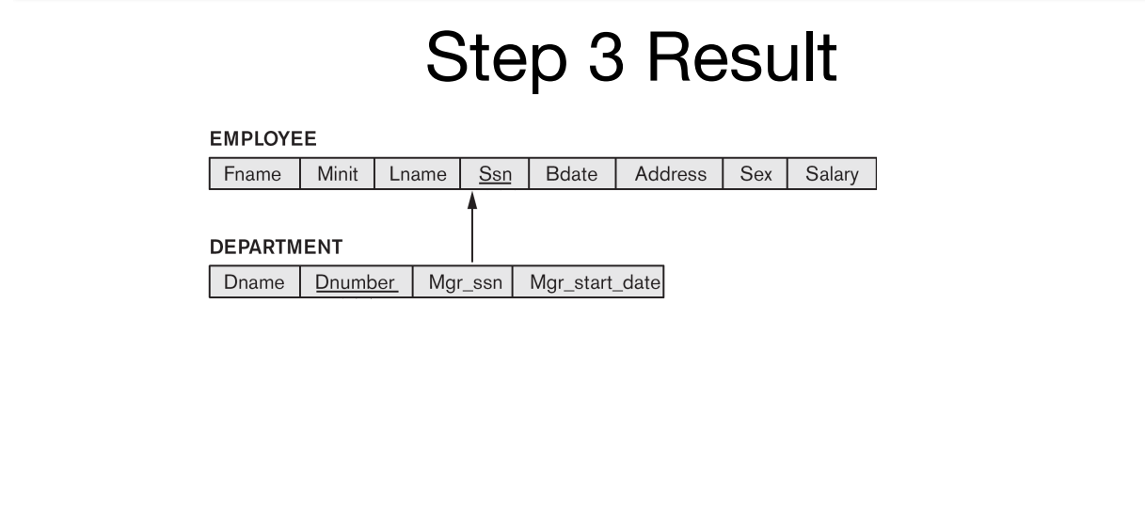

Slide 12
Step 4: Binary 1-to-N
Choose the S relation as the type at the N-side of the relationship, other is T
Add as a foreign key to S all of the primary key attribute(s) of T
Another approach: create a relationship relation

Slide 13
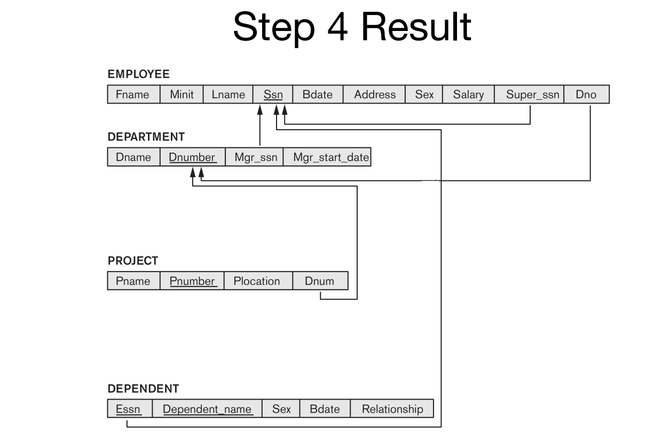
ER TO RELATION

Slide 14
Step 5: Binary M-to-N
i. Create a new relation S (termed: relationship relation) – In some ERD dialects, actually drawn in
ii. Add as foreign keys the primary keys of both relations; their combination forms the primary key of S
iii. Add any simple attributes of the M:N relationship to S

Slide 15
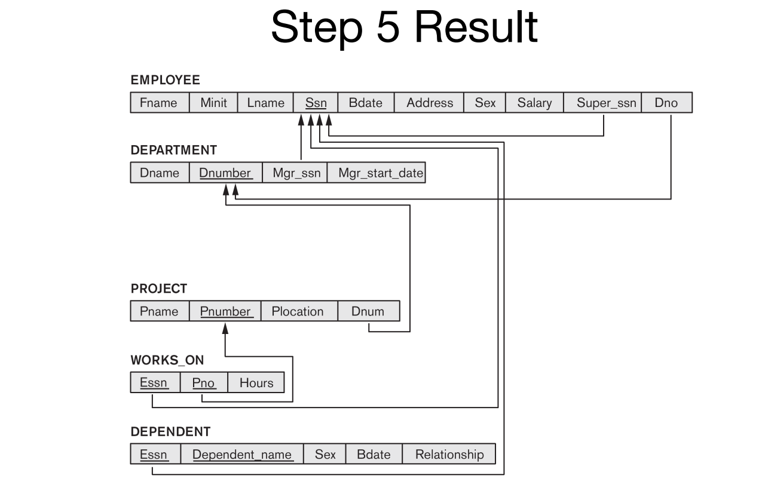
STEP:5

Slide 16
Step 6: Multivalued Attributes
Create a new relation S
Add as foreign keys the primary keys of the corresponding relation
Add the attribute to S (if composite, the simple attributes);
the combination of all attributes in S forms the primary key

Slide 17
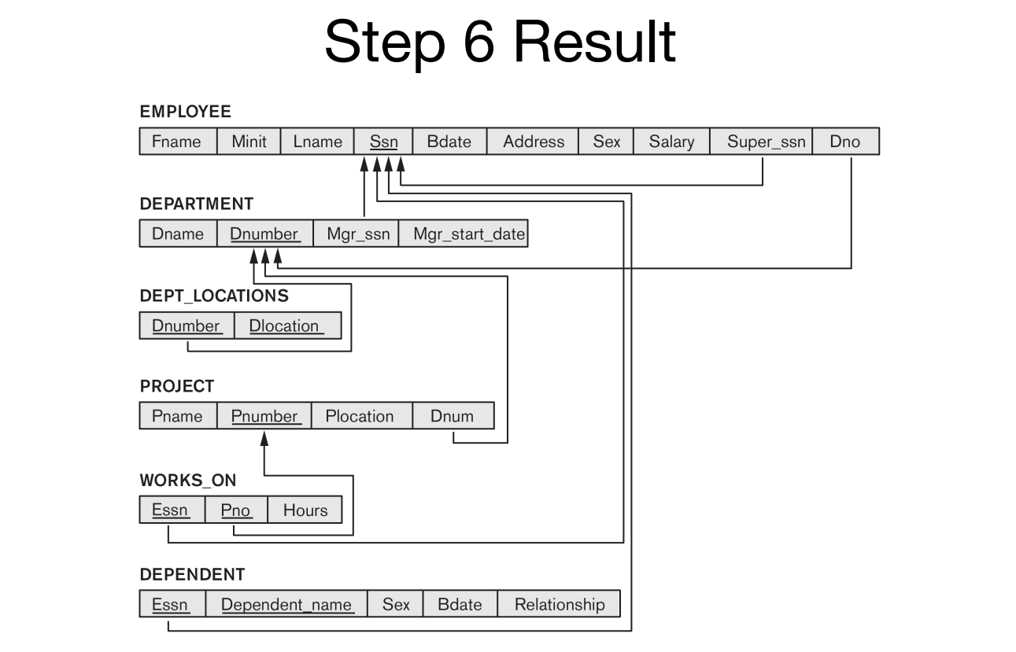

Slide 18
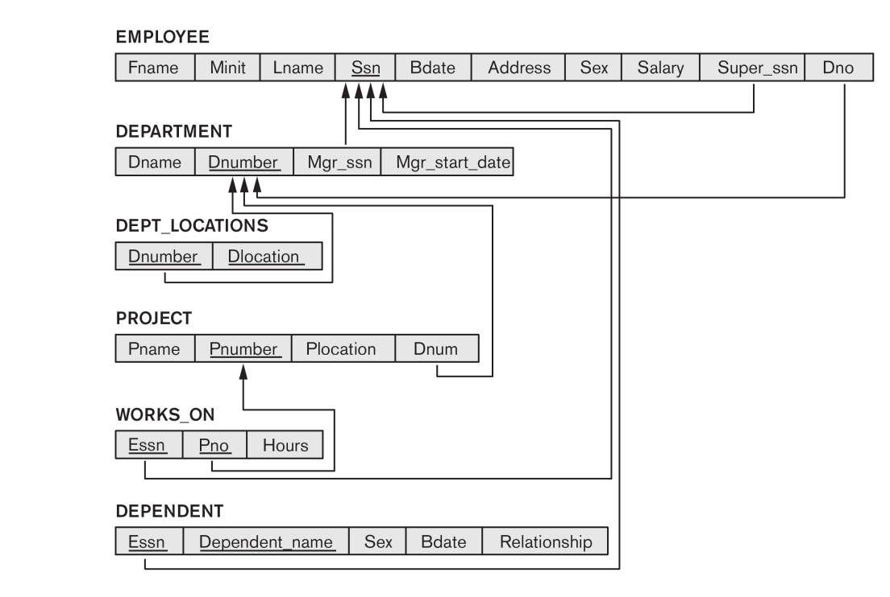
Final result of relational design mapping

Slide 19
Summary
Mapping from ERDs to relations is an algorithmic process

